Slide 1

Exhaustive Analysis of Indian Agriculture Sector Using Power BI
A Data Driven Exploration of Crop Production Trends in India
Presented by Ankamma

Slide 2
Content
Introduction
Objectives
Key Performance Indicators
Data Dictionary
Project Roadmap

Slide 3
Introduction
Dataset: Indian Agricultural Crops Dataset with 73,827 records.
Attributes: State_Name, District_Name, Crop _ear, Season, Crop, Area, and Production.
Goal: Uncover key trends, productivity insights, and high-performing states and crops.
Why this dataset? Agriculture contributes over 18% to India’s GDP and provides real-world insight.

Slide 4
Objectives
Analyze crop production trends by region, crop, and season.
Identify top-performing crops and high-yield states.
Visualize production and area relationships using Power BI.
Develop interactive dashboards for data driven decisions.
Support policymakers and researchers through insights.

Slide 5
Key Performance Indicators
Total Production: Total crop yield across regions and years.
Total Cultivated Area: Total agricultural land used for cultivation.
Average Yield: Ratio of production to area (efficiency measure).
Top Performing Crop: Crop with maximum total production.
Highest Producing State: State leading in total output.

Slide 6
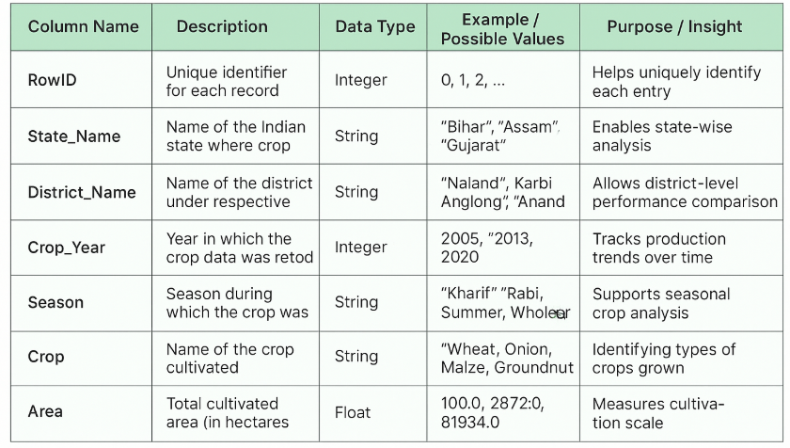
Data Dictionary

Slide 7
Project Roadmap
Step 1: Data Understanding & Cleaning.
Step 2: Exploratory Data Analysis (EDA).
Step 3: Dashboard Development in Power BI.
Step 4: Insights & Presentation.

Slide 8
Thank You / Q&A
Thank you for your attention!
Questions or feedback are welcome.
Presented by Ankamma

